Slide 1
Research Paradigms on
LLM and Personalization
Meng Jiang
Department of Computer Science and Engineering
University of Notre Dame

Slide 2
Terminology Blocks
large language model
Tool:
Goal:
Research Paradigms?
personalization
Application:
personalized
recommendation
personal data
“multi-task learner”
persona
chat / assistant

Slide 3
Research Paradigms
RP1: Personalization for LLM
RP2: LLM for Personalization
RP3: Personalized LLMs

Slide 4
RP1: Personalization for LLM
chatbot
LLM
Task input
Task output
virtual assistant
as a multi-task learner
…
Persona
Personalized recommendation
(recommended items)
User modeling modules
(built)
Recommendation modules
(built)
Personal data

Slide 5
RP1: Personalization for LLM
LLMs are multi-task learners^{[1]} in a text-to-text manner.^{[2]}
LLMs gained massive knowledge from pre-training.^{[3]}
Many tasks need personalized knowledge (PK): e.g., persona for chatbot, personalized recommendation for virtual assistance.
LLM input must be augmented with textual PK from existing personalization modules: Retrieval-augmented generation (RAG)^{[4]}
LLM must be fine-tuned to follow instructions of using PK: Instruction(-augmented) fine-tuning (IFT)^{[5]}
[1] Language Models are Unsupervised Multitask Learners. (OpenAI 2019)
[2] Exploring the Limits of Transfer Learning with a Unified Text-to-Text Transformer. (Google 2020)
[3] Improving Language Understanding by Generative Pre-Training (OpenAI 2018)
[4] Retrieval-Augmented Generation for Knowledge-Intensive NLP Tasks (Facebook AI 2020)
[5] Training Language Models to Follow Instructions with Human Feedback. (OpenAI 2022)

Slide 6
Knowledge-Augmented NLP
“Open-Book” and Knowledge Heterogeneity
External
knowledge
sources
Survey paper:
A Survey of Knowledge-Enhanced Text Generation. ACM Computing Surveys, 2022.
Tutorials:
Knowledge-Enriched Natural Language Generation. EMNLP 2021.
Knowledge-Augmented Methods for NLP. ACL 2022.
Knowledge-Augmented Methods for NLP. WSDM 2023.
Workshops:
KnowledgeNLP-AAAI 2023. https://knowledge-nlp.github.io/aaai2023/
KnowledgeNLP-KDD 2023. https://knowledge-nlp.github.io/kdd2023/
KnowledgeNLP-ACL 2024. (August 11-16 in Bangkok, Thailand)
Wikipedia
News
Database
Social media
…
Retriever
Input
Knowledge
(e.g., passages)
Output
tasks
Reader, Generator, or Large Language Model

Slide 7
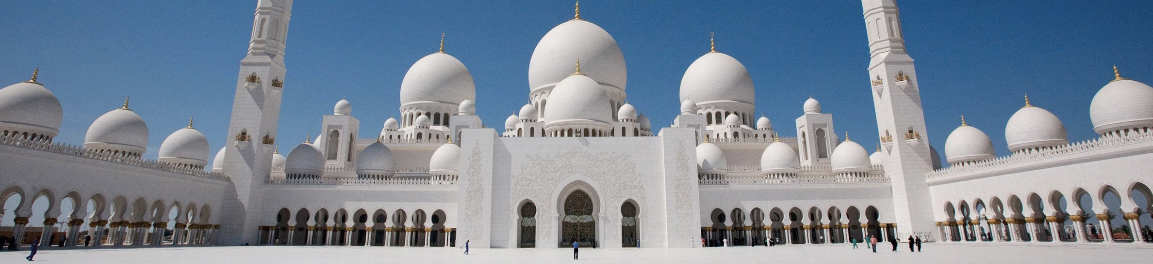



Retrieval Augmentation for Commonsense Reasoning: A Unified Approach
Abu Dhabi
The 2022 Conference on Empirical Methods in Natural Language Processing
Wenhao Yu, Chenguang Zhu, Zhihan Zhang, Shuohang Wang, Zhuosheng Zhang, Yuwei Fang, Meng Jiang

Slide 8
Multi-choice Commonsense Question Answering
Commonsense Fact Verification
Where can I stand on a river to see water falling without getting wet?
A pound of cotton has the same weight as a pound of steel.
A) waterfall
B) bridge
C) valley
D) stream
E) bottom
True
False
Datasets:
OpenBookQA: Clark et al. arxiv 2018. (5,957 questions)
CommonsenseQA 1.0： Talmor et al. NAACL 2019. (12,102)
Evaluation: Accuracy.
Datasets:
CommonsenseQA 2.0: Talmor et al. (14,343 assertions)
CREAK： Onoe et al. NeurIPS 2021 Benchmark Track. (13,000)
Evaluation: Accuracy.
Constrained Commonsense Generation
Counterfactual Explanation Generation
Constraints: dog, frisbee, catch, throw
I am hungry for water.
Description: A girl throws a frisbee and her dog catches it.
Outputs:
1) Water is used to quench thirsty.
2) You are thirsty for water, not hungry.
3) Water is not food.
Datasets:
CommonGen: Lin et al. Findings of EMNLP 2020. (79,000+ commonsense descriptions)
Evaluation: SPICE, BLEU-4, ROUGE-L, CIDEr.
Datasets:
ComVE: Wang et al. SemEval-2020 Task 4 (11,997 examples)
Evaluation: SPICE, BLEU-4, ROUGE-L, CIDEr.

Slide 9
Commonsense Benchmark Datasets
Where can I stand on a river to see water falling without getting wet?
αNLI
COSMOSQA
HELLA
SWAG
A) waterfall
B) bridge
C) valley
D) stream
E) bottom
PIQA
SOCIAL
IQA
…
A pound of cotton has the same weight as a pound of steel.
Human Annotated Facts
(e.g., Relations, Knowledge Graphs)
True
False
Constraints: dog, frisbee, catch, throw
OMCS
ATOMIC
Wiktionary
Description: A girl throws a frisbee and her dog catches it.
…
I am hungry for water.
Commonsense Relevant Corpus
(e.g., Statements, Knowledge Bases)
Outputs:
1) Water is used to quench thirsty.
2) You are thirsty for water, not hungry.
3) Water is not food.
ARC
QASC
GenericsKB
…

Slide 10
Unified Approach
Retrieval Augmentation for Commonsense Reasoning (RACo)
Dense Passage Retriever
Large-Scale
Commonsense
Corpus
Commonsense Benchmark Datasets
Source Heterogeneity
(e.g., transform KG / KB)
Human Annotated Facts
(e.g., Relations, Knowledge Graphs)
Commonsense Relevant Corpus
(e.g., Statements, Knowledge Bases)
Input
Retrieved Passages
Output
Generator
(as classifier if needed)
Multi-choice Commonsense Question Answering
Commonsense Fact Verification
Training Retriever without golden passages
Constrained Commonsense Generation
Counterfactual Explanation Generation

Slide 11
Multi-choice Commonsense Question Answering
Commonsense Fact Verification
(Accuracy) | CSQA1.0 | OBQA
RACo | 75.76 | 71.25
GreaseLM | 74.20 | 66.90
QA-GNN | 73.40 | 67.80
UNICORN | 71.60 | 70.02
T5-Large | 70.14 | 66.02
KAGNet | 69.00 | -
(Accuracy) | CSQA2.0 | CREAK
RACo | 61.75 | 84.17
UNICORN | 54.90 | 79.51
GreaseLM | - | 77.51
T5-Large | 54.60 | 77.32
🏆
🏆
Constrained Commonsense Generation
Counterfactual Explanation Generation
CommonGen | (BL-4) | (SPICE)
RACo | 42.76 | 33.89
KFCNet | 41.97 | 33.11
UNICORN | 39.86 | 33.20
KG-BART | 30.90 | 32.70
CALM | 29.50 | 30.20
T5-Large | 28.60 | 31.60
ComVE | (BL-4) | (SPICE)
RACo | 25.30 | 36.37
UNICORN | 24.46 | 35.79
CALM | 23.50 | 35.23
MoKGE | 22.87 | 34.88
T5-Large | 22.77 | 34.62
GraphRF | 22.07 | 33.09
🏆
🏆

Slide 12
RP1: Personalization for LLM
LLMs are multi-task learners^{[1]} in a text-to-text manner.^{[2]}
LLMs gained massive knowledge from pre-training.^{[3]}
Many tasks need personalized knowledge (PK): e.g., persona for chatbot, personalized recommendation for virtual assistance.
LLM input must be augmented with textual PK from existing personalization modules: Retrieval-augmented generation (RAG)^{[4]}
LLM must be fine-tuned to follow instructions of using PK: Instruction(-augmented) fine-tuning (IFT)^{[5]}
[1] Language Models are Unsupervised Multitask Learners. (OpenAI 2019)
[2] Exploring the Limits of Transfer Learning with a Unified Text-to-Text Transformer. (Google 2020)
[3] Improving Language Understanding by Generative Pre-Training (OpenAI 2018)
[4] Retrieval-Augmented Generation for Knowledge-Intensive NLP Tasks (Facebook AI 2020)
[5] Training Language Models to Follow Instructions with Human Feedback. (OpenAI 2022)

Slide 13
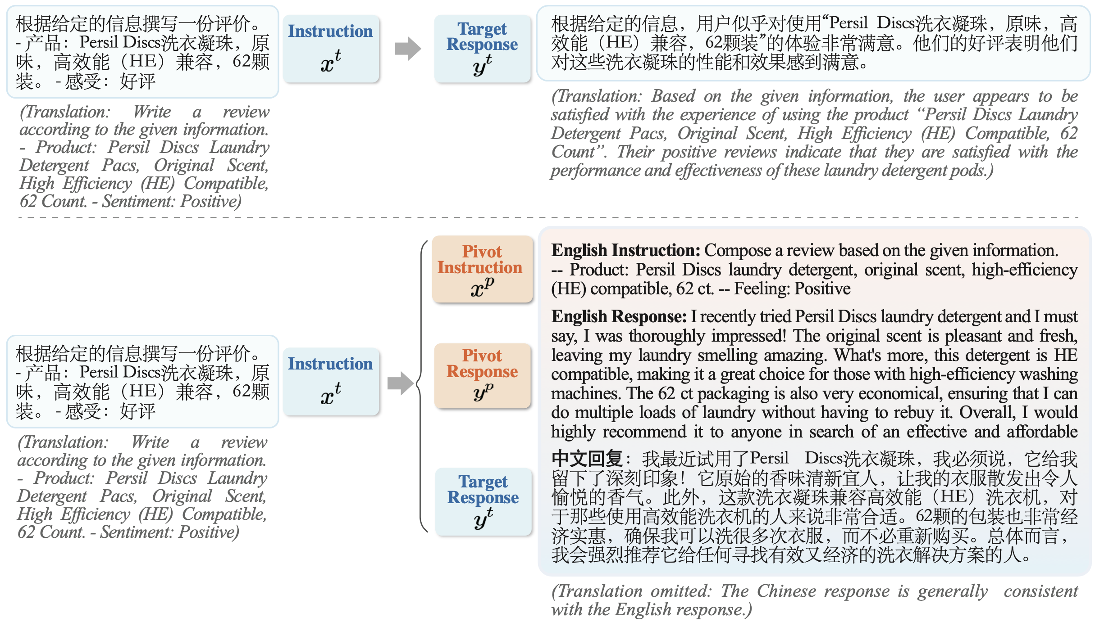
Zhang et al. PLUG: Leveraging Pivot Language in Cross-Lingual Instruction Tuning.

Slide 14
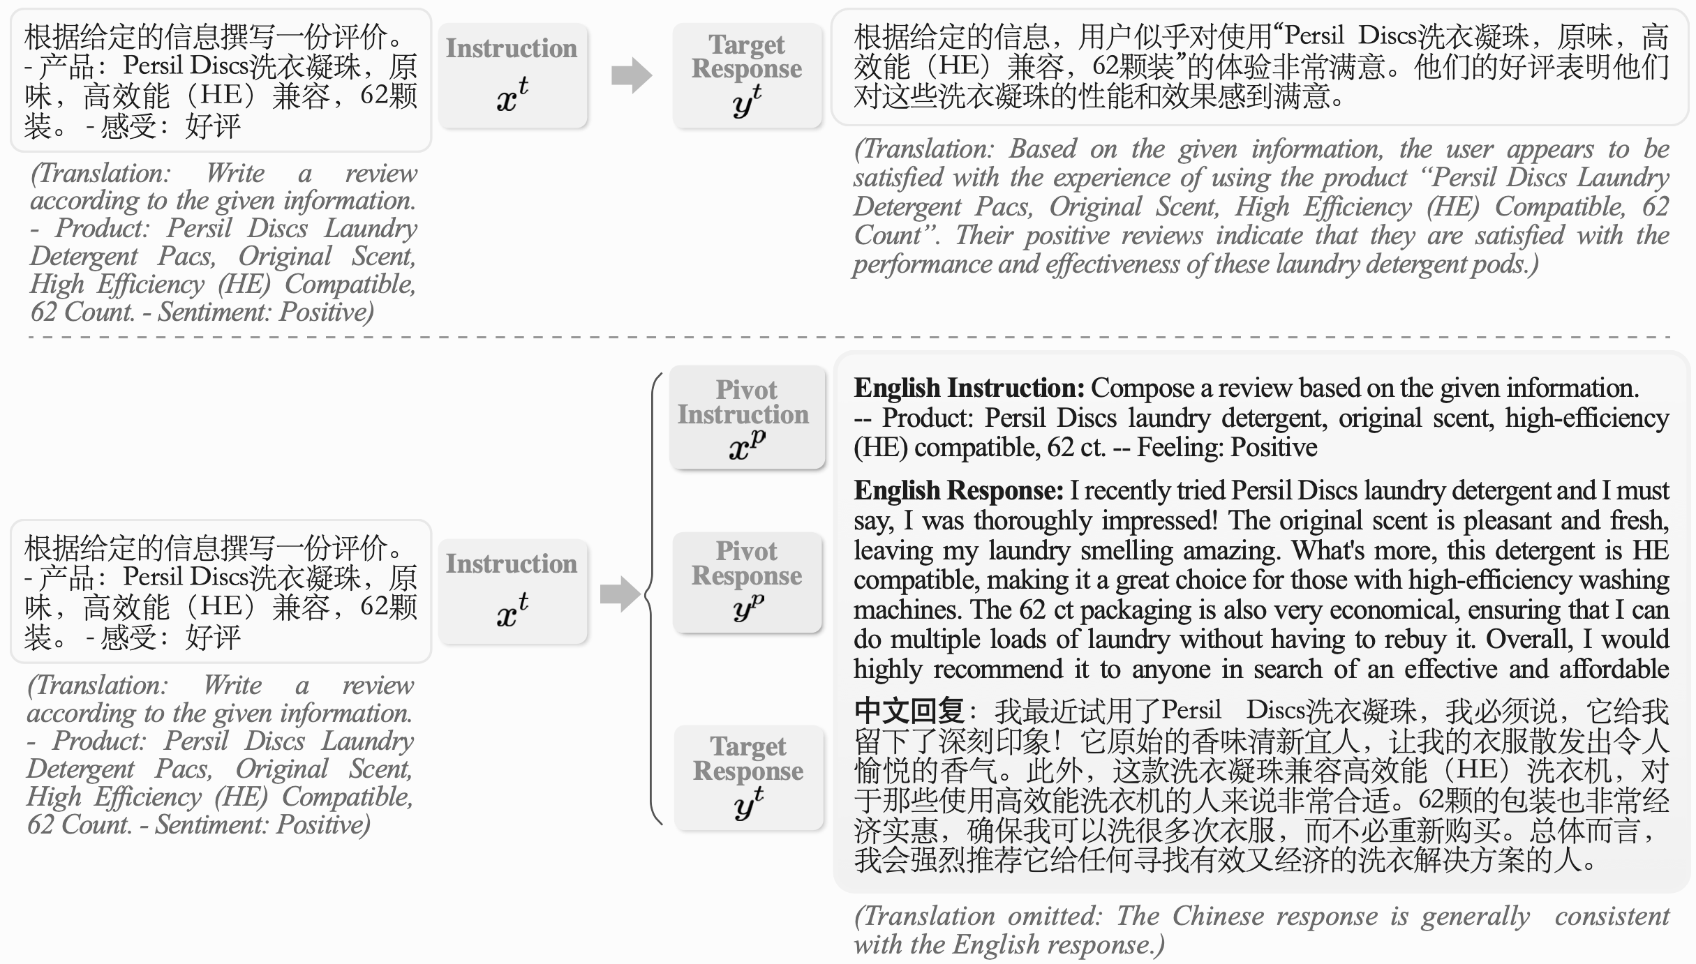
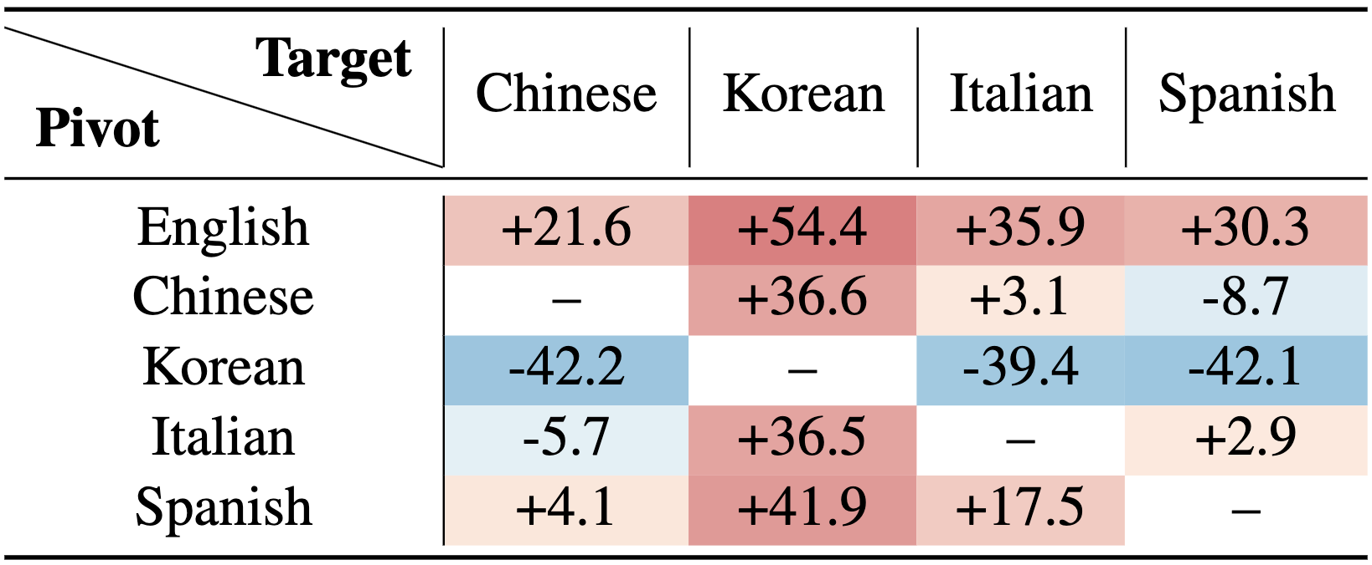
Instruction fine-tuned (IFT) LLaMA-2-13B
Zhang et al. PLUG: Leveraging Pivot Language in Cross-Lingual Instruction Tuning.

Slide 15
Research Paradigms
RP1: Personalization for LLM
RP2: LLM for Personalization
RP3: Personalized LLM

Slide 16
RP2: LLM for Personalization
User Modeling
Recommender Systems
Behavior database
Recommended items
LLM
Personal data
LLMs as Predictors: classifier, ranker, scoring, etc.
LLMs as Enhancers: profiler, feature encoder, etc.
LLMs as Controllers: what action and when
LLMs as Evaluators

Slide 17
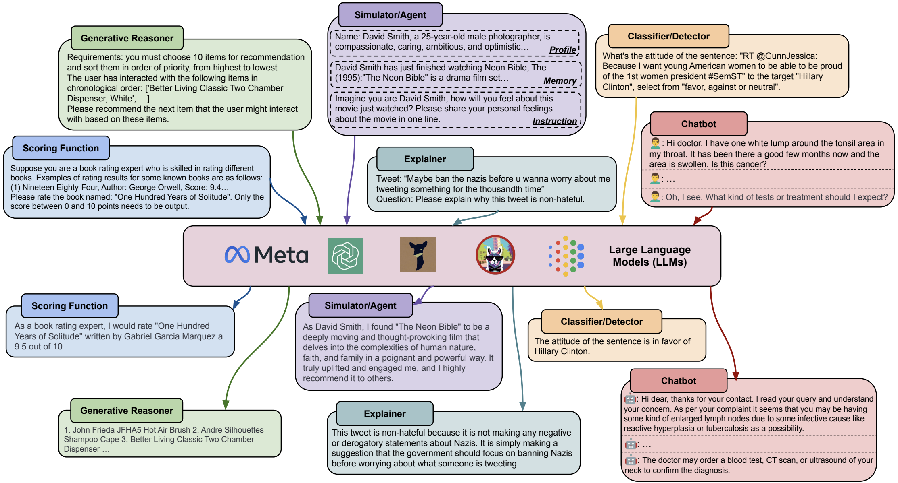
LLMs as Predictors

Slide 18
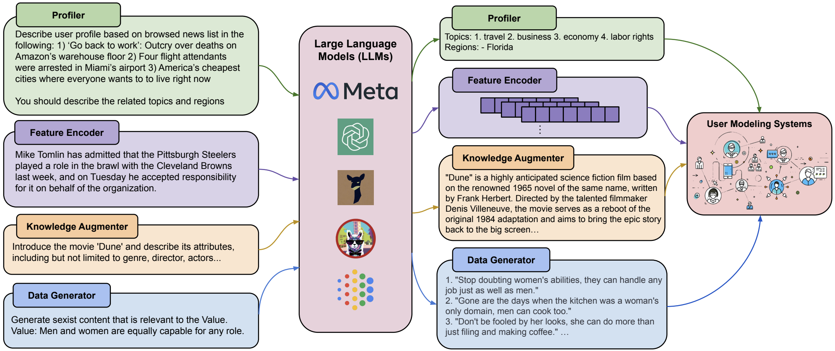
LLMs as Enhancers

Slide 19
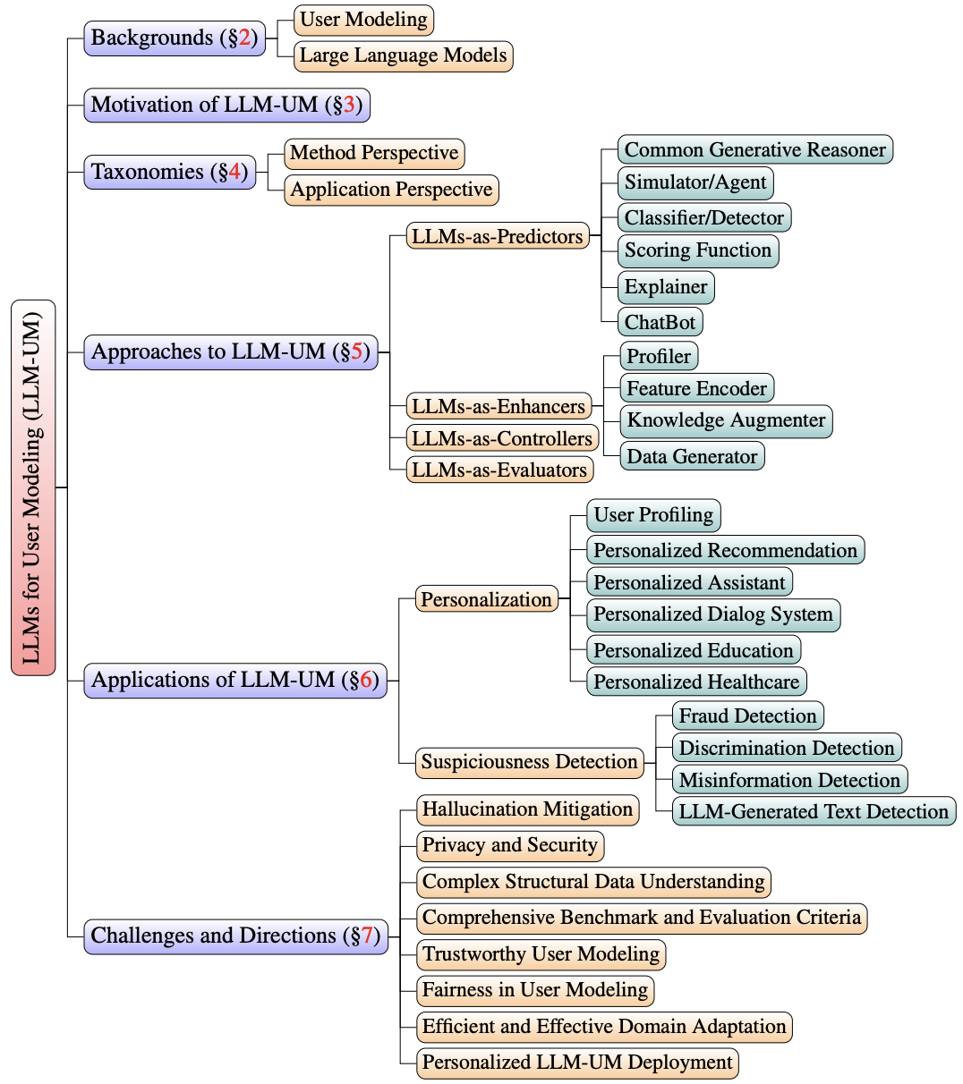
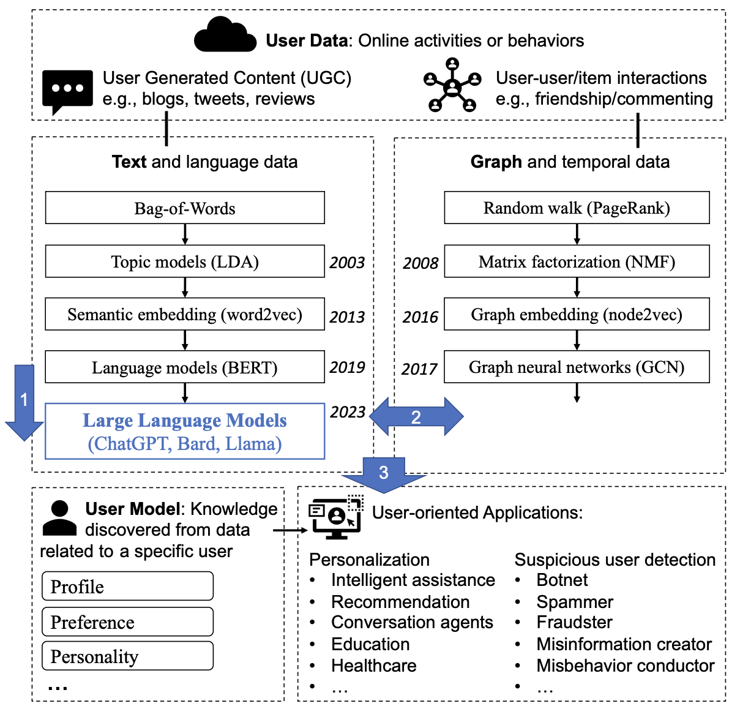
Tan and Jiang. User Modeling in the Era of Large Language Models: Current Research and Future Directions. IEEE Data Engineering Bulletin Issues, December 2023.

Slide 20




RP3: Personalized LLMs
spatiotemporal complexity
heterogeneity
…
Personalization and Democratization
$$$
$$$
$$$
Personal data
LLM
Personal data
LLM
LLM
prompting
fine-tuning
$$$
Personal data
who owns it?
who owns it?
$$$
$$$
Comment:
Whether to use a fine-tuning vs a pure-prompting approach is almost certainly going to be a resource vs quality issue. Storing whole models for each user is cost prohibitive, but it is possible for small number of parameters to be stored to personalize the LLM using e.g. LoRA-like techniques.
LLM
Personal data
LLM
fine-tuning

Slide 21
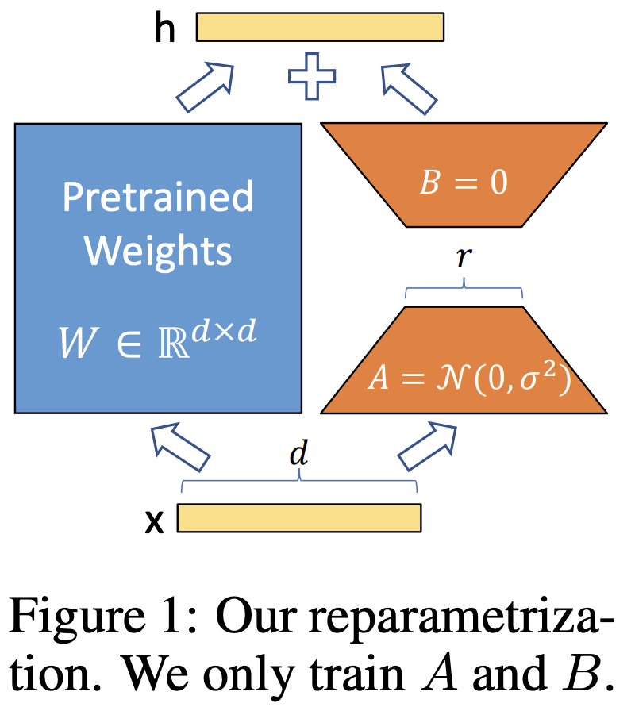
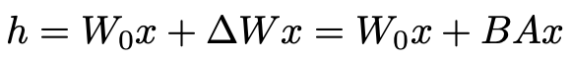
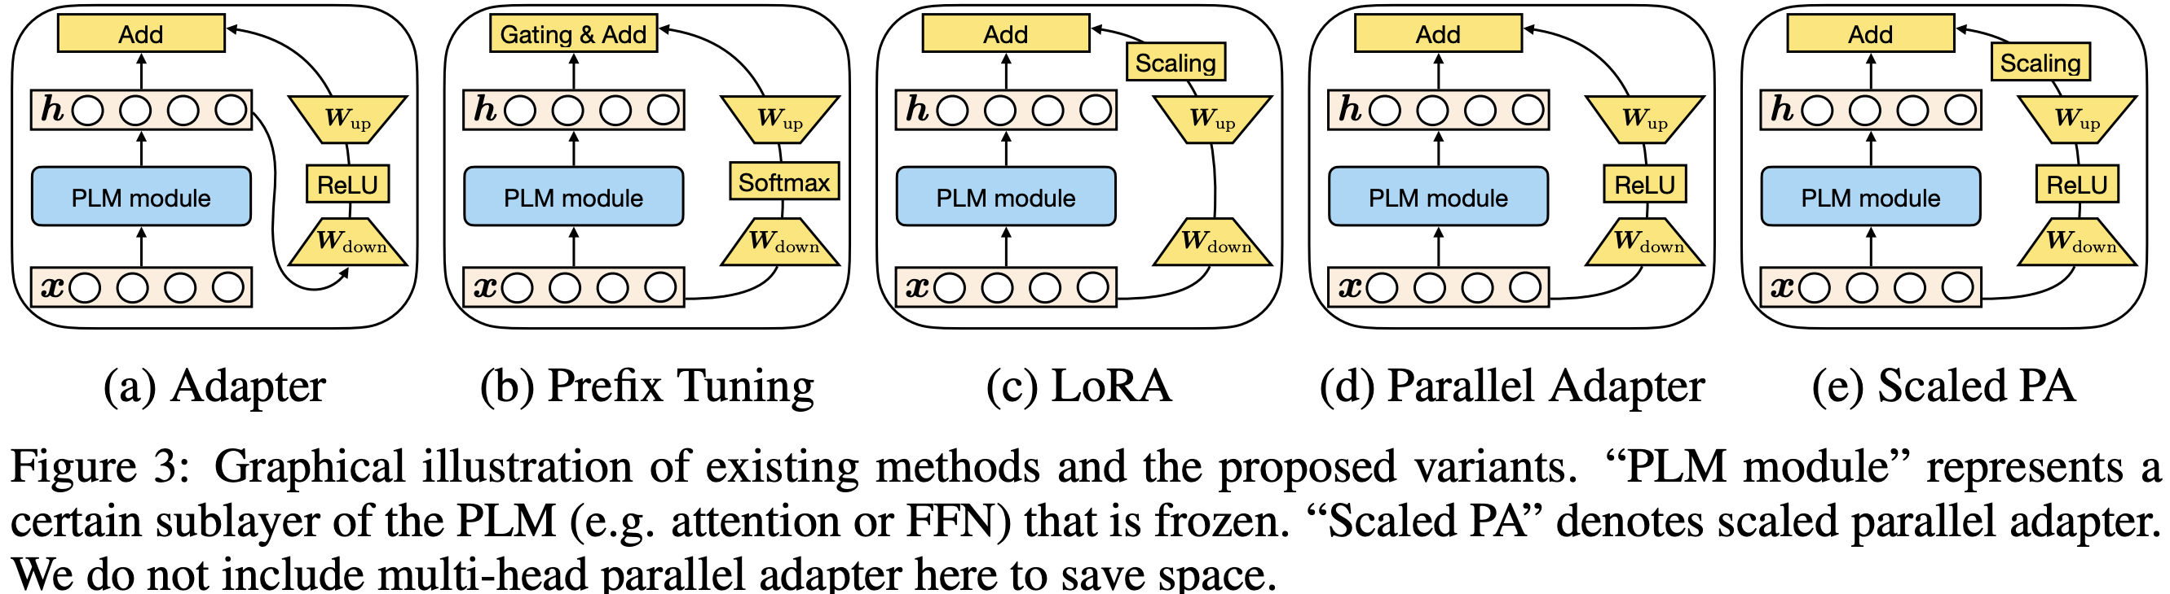
Parameter-Efficient Fine-Tuning (PEFT)
LoRA: Low-Rank Adaptation of Large Language Models. ICLR 2022.
Towards a Unified View of Parameter-Efficient Transfer Learning. ICLR 2022.

Slide 22
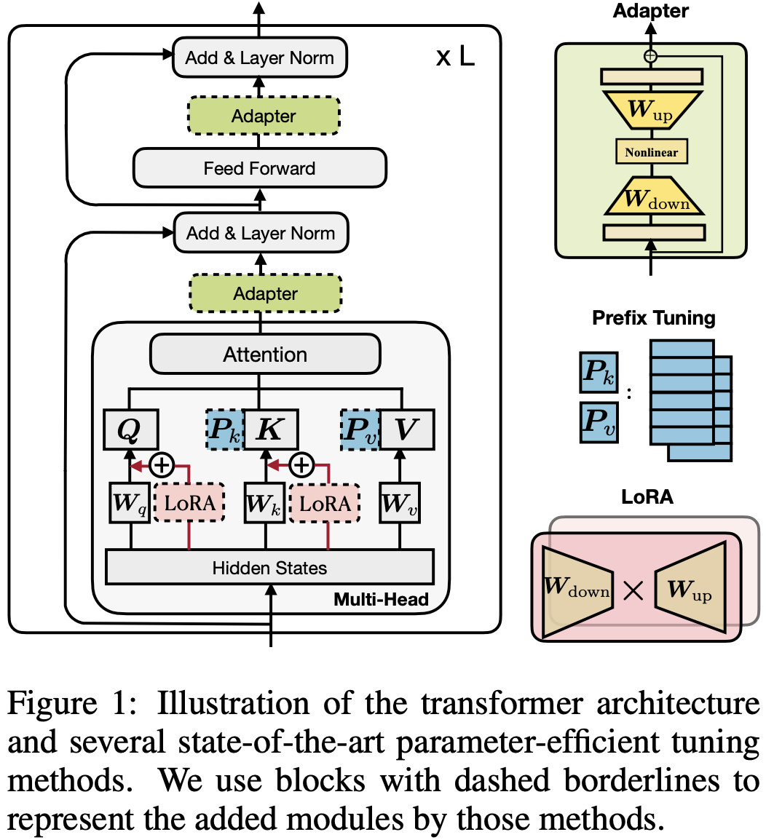
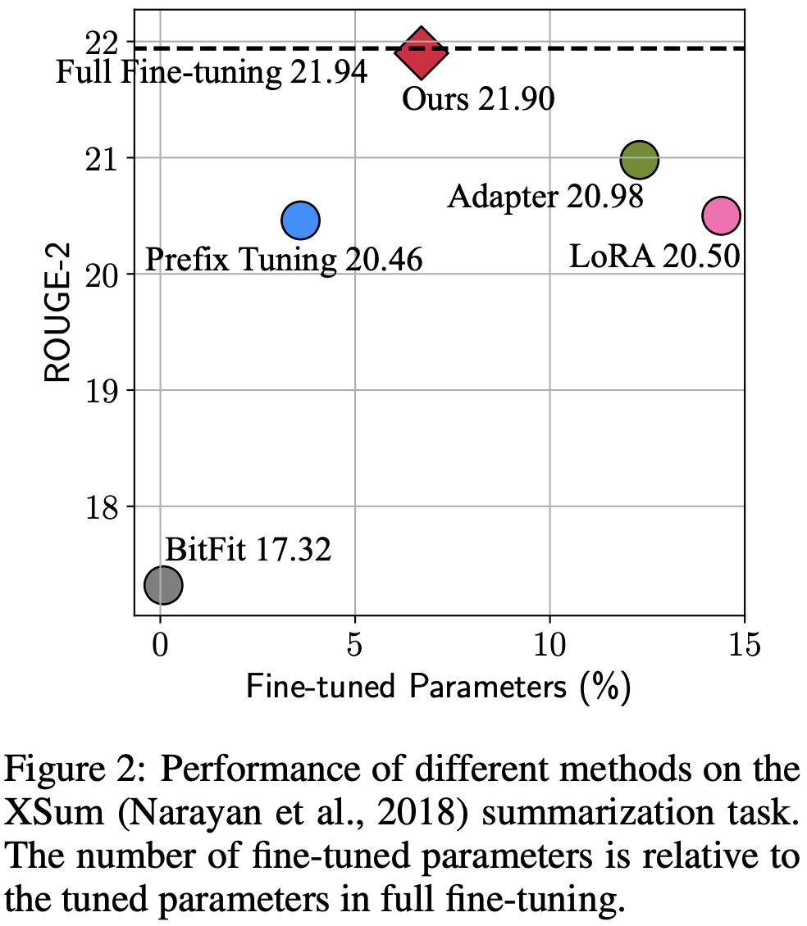
Parameter-Efficient Fine-Tuning (PEFT)
Towards a Unified View of Parameter-Efficient Transfer Learning. ICLR 2022.

Slide 23
Democratizing LLMs via Personalized PEFT
Tan et al. Democratizing large language models via personalized parameter-efficient fine-tuning. Under Review.

Slide 24
Results on 100 Most Active Users
Tasks in LaMP ^{[1]} | Metric | Non-Personalized | Personalized Prompting | Personalized PEFT + Prompting
Personalized citation identification | Acc ↑ F1 ↑ | 0.650 0.647 | 0.659 0.657 | 0.797 0.794
Personalized news categorization | Acc ↑ F1 ↑ | 0.785 0.527 | 0.820 0.598 | 0.838 0.661
Personalized movie tagging | Acc ↑ F1 ↑ | 0.499 0.441 | 0.587 0.512 | 0.648 0.553
Personalized product rating | MAE ↓ RMSE ↓ | 0.259 0.590 | 0.214 0.535 | 0.143 0.378
Personalized news headline generation | R-1 ↑ R-L ↑ | 0.187 0.168 | 0.191 0.172 | 0.199 0.180
Personalized scholarly title generation | R-1 ↑ R-L ↑ | 0.478 0.418 | 0.505 0.445 | 0.526 0.473
Personalized tweet paraphrasing | R-1 ↑ R-L ↑ | 0.524 0.474 | 0.568 0.521 | 0.581 0.533
[1] LaMP: When Large Language Models Meet Personalization. 2023. https://lamp-benchmark.github.io/

Slide 25
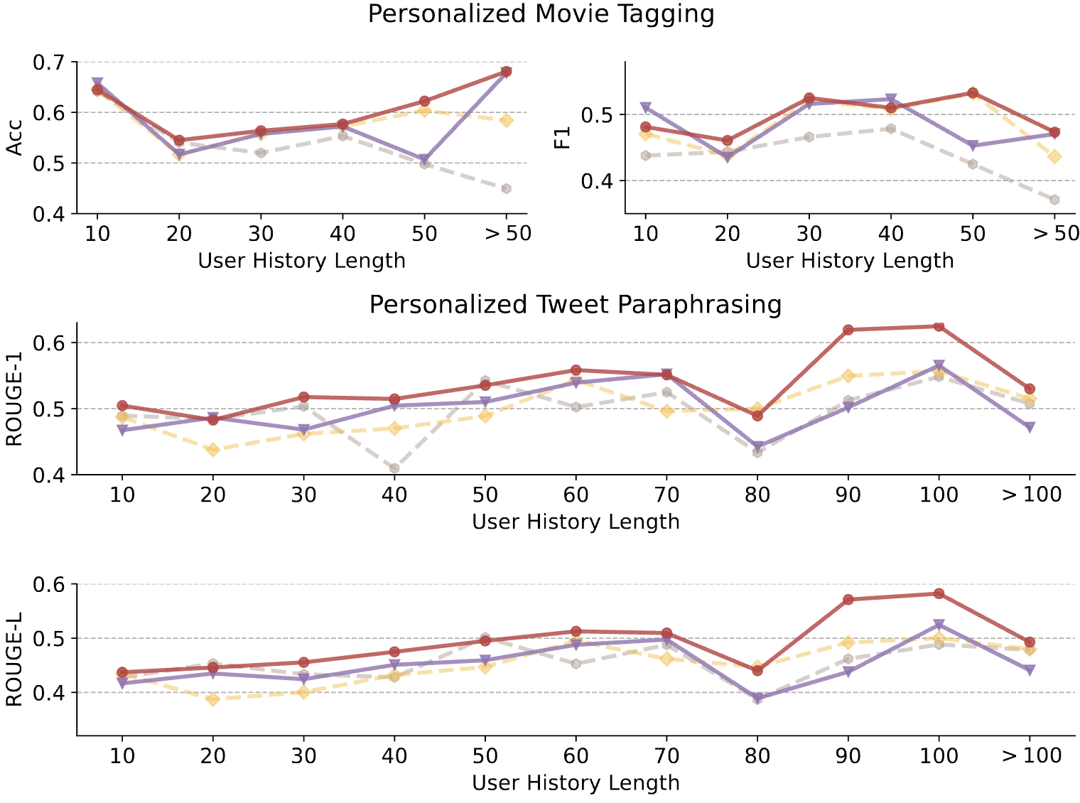
Results on Activity Levels
Personalized PEFT + Prompting
Personalized PEFT
Personalized Prompting
Non-personalized

Slide 26
Future Work in RP3
Trade-off among LLM Ownership & Personalization and Efficiency
Build cohort-personalized LLMs (user groups vs individuals).
Build personalized LLMs for cold-start users.
Explore compositional architectures in personalized PEFT.
Ownership: from data value to model value, improving user’s initiatives on generating data ($$$).

Slide 27
Take Away
Three Research Paradigms on LLM and Personalization
RP1: Personalization for LLM
Knowledge Augmentation: RAG, RACo^{(Yu et al. 2022)}
Instruction Tuning: Cross-lingual IFT^{(Zhang et al. 2024)}
RP2: LLM for Personalization
Survey on LLM-User Modeling: LLMs as Predictors / Enhancers / Controllers / Evaluators^{(Tan and Jiang 2023)}
RP3: Personalized LLMs
Democratization via Personalized PEFT^{(Tan et al. 2024)}

Slide 28
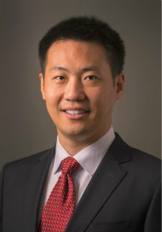
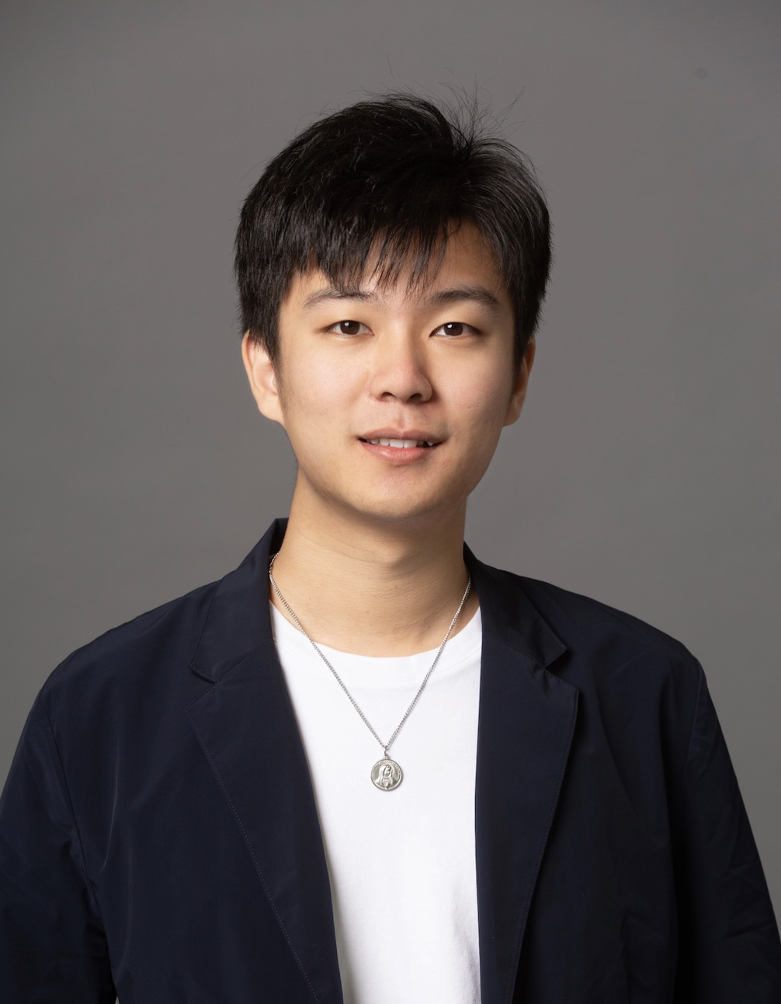
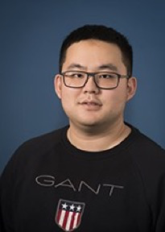
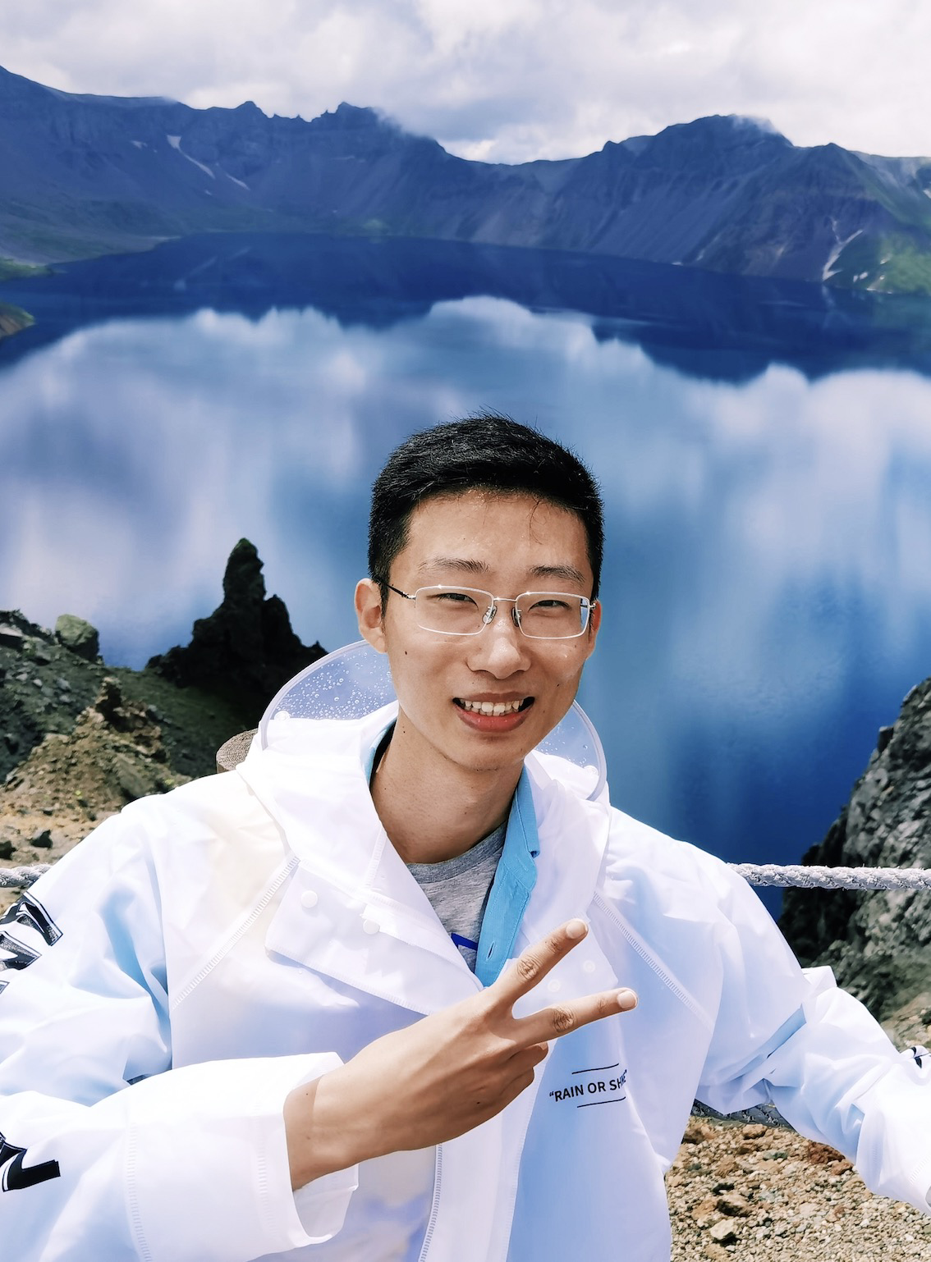
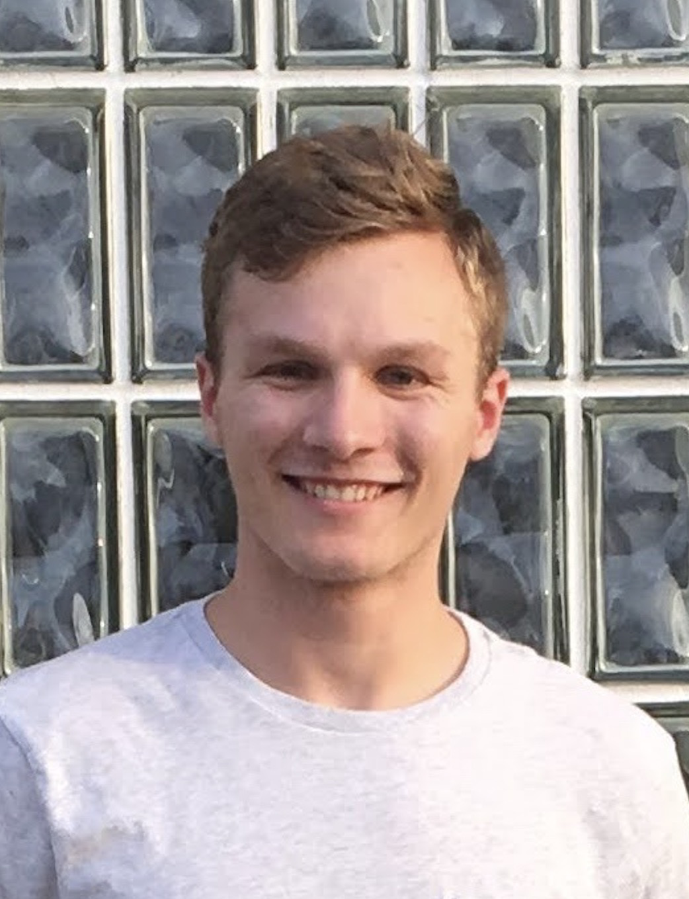
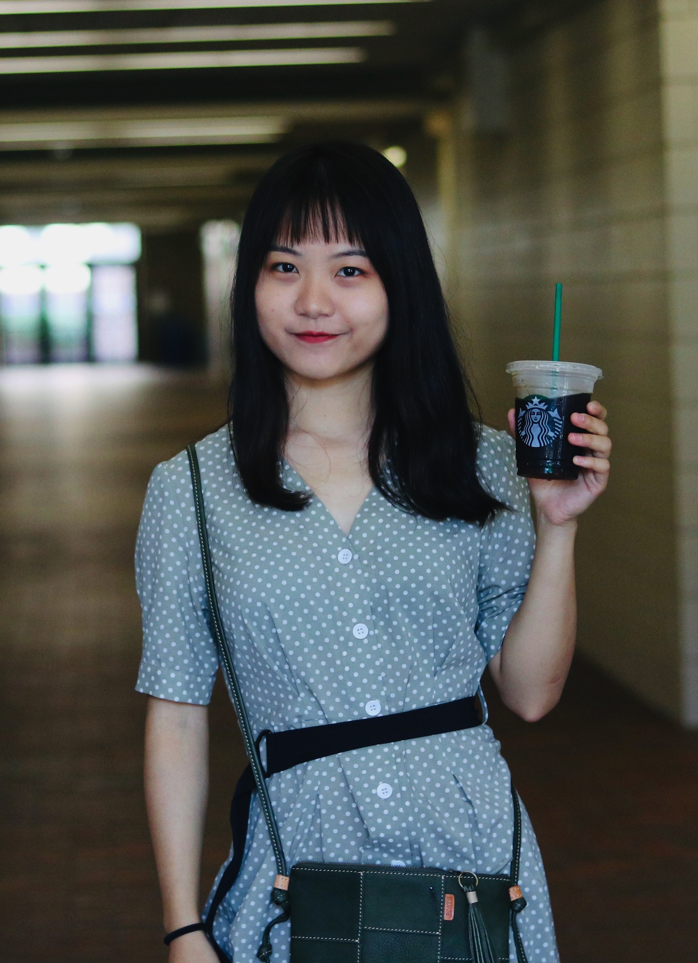
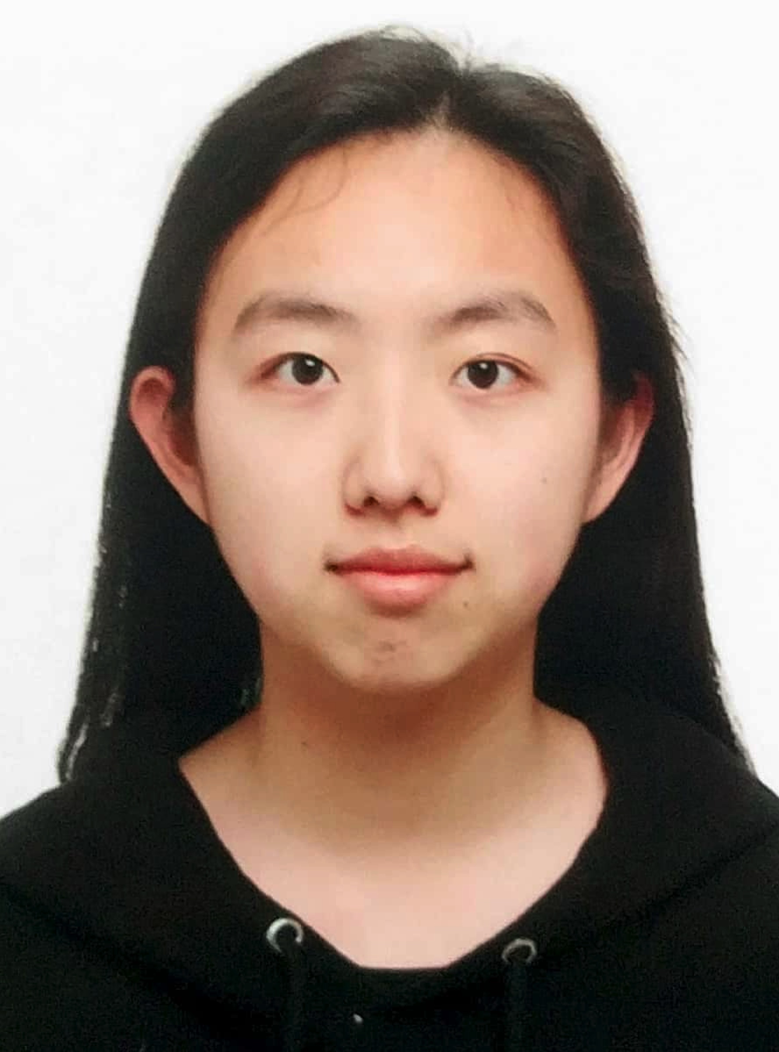

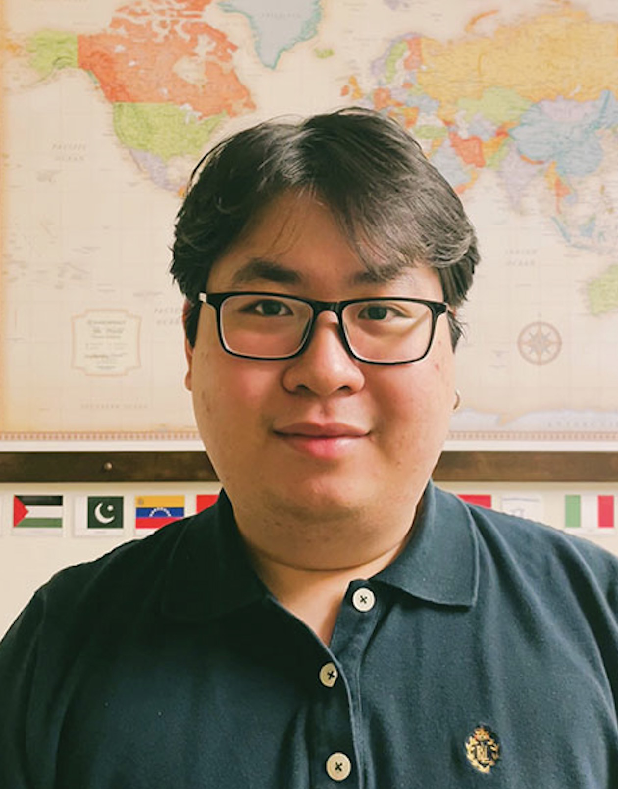
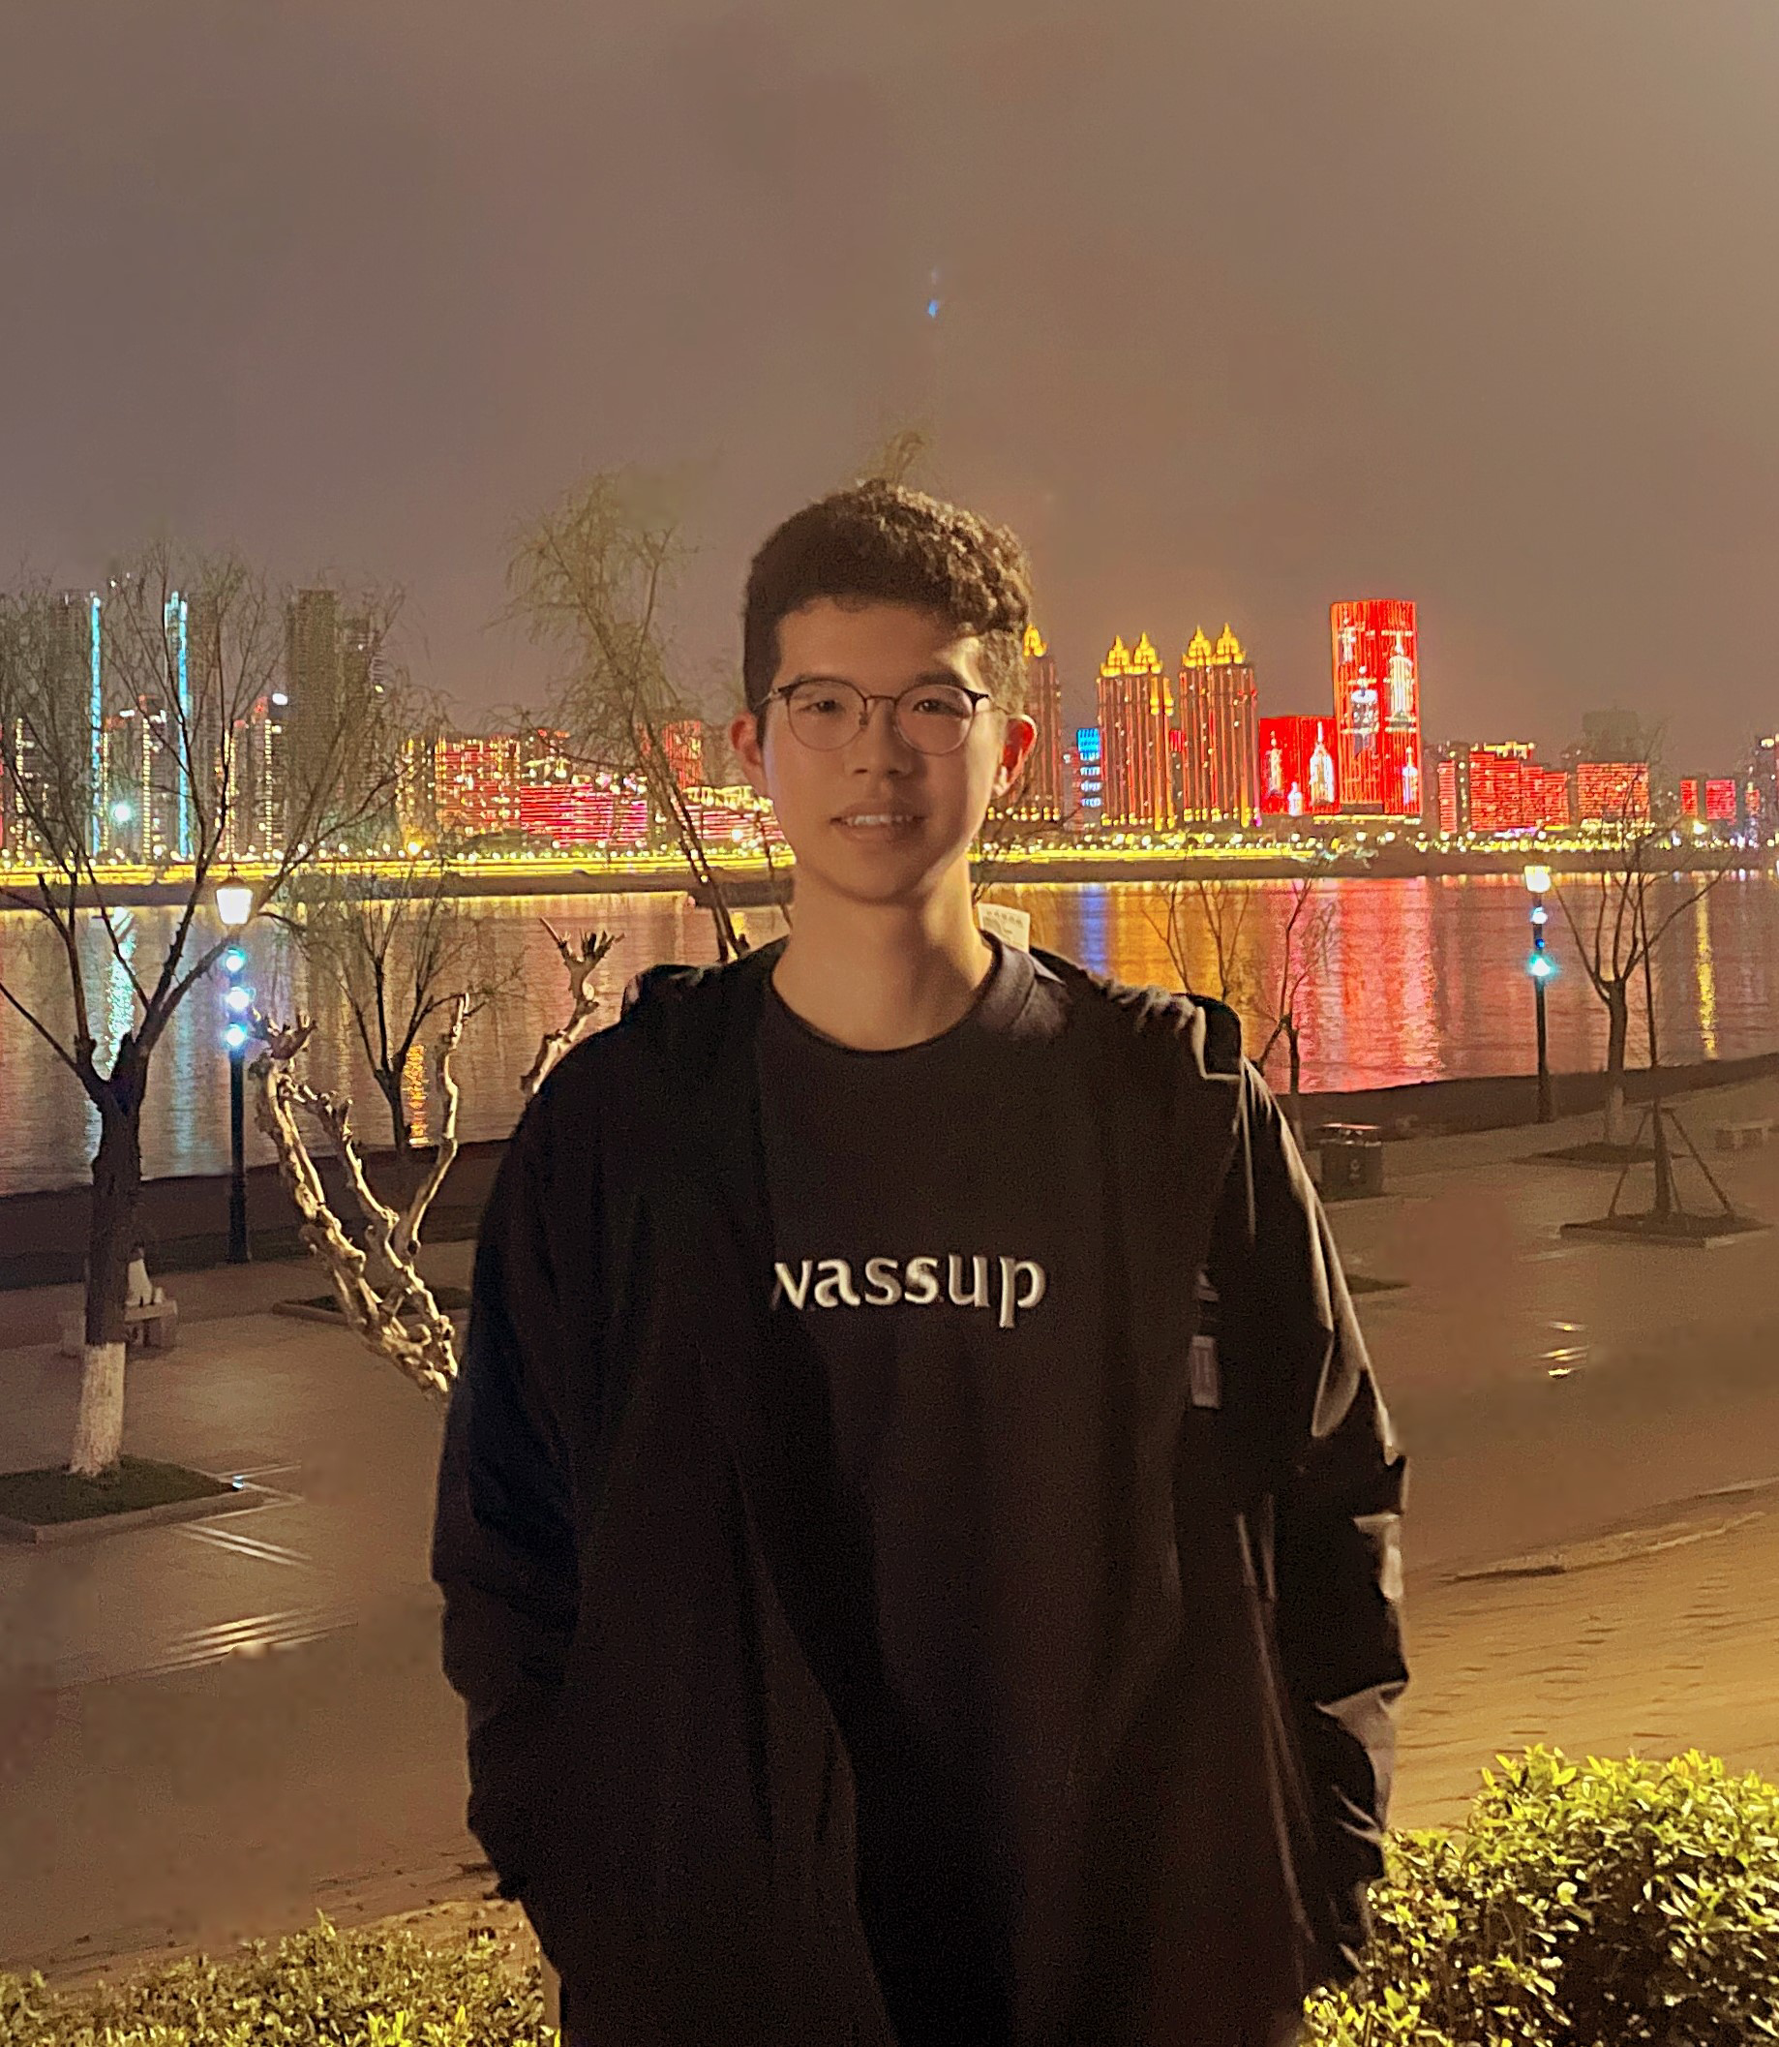
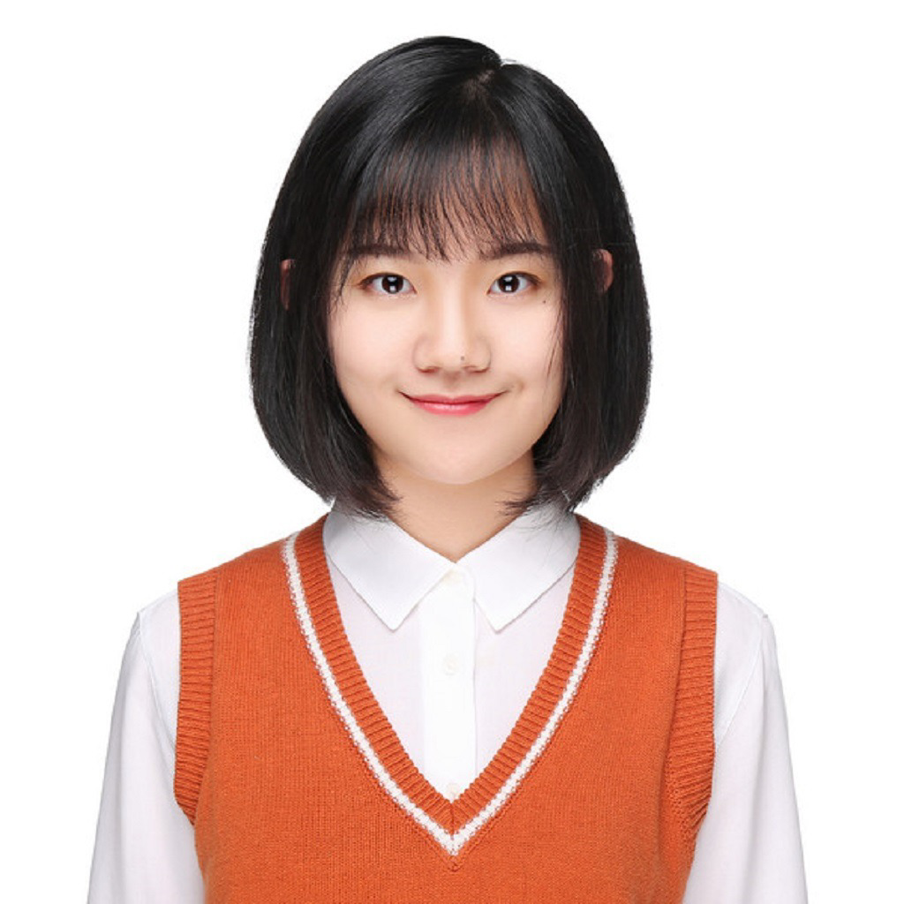
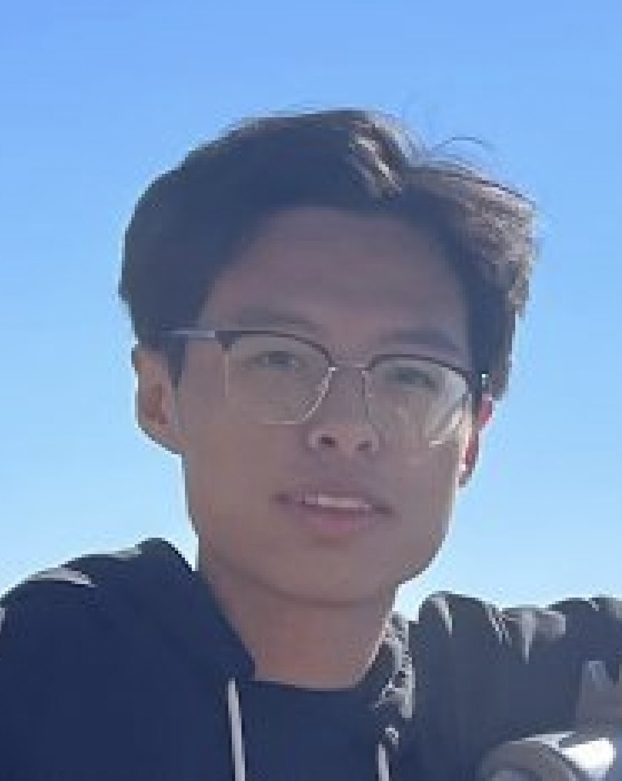
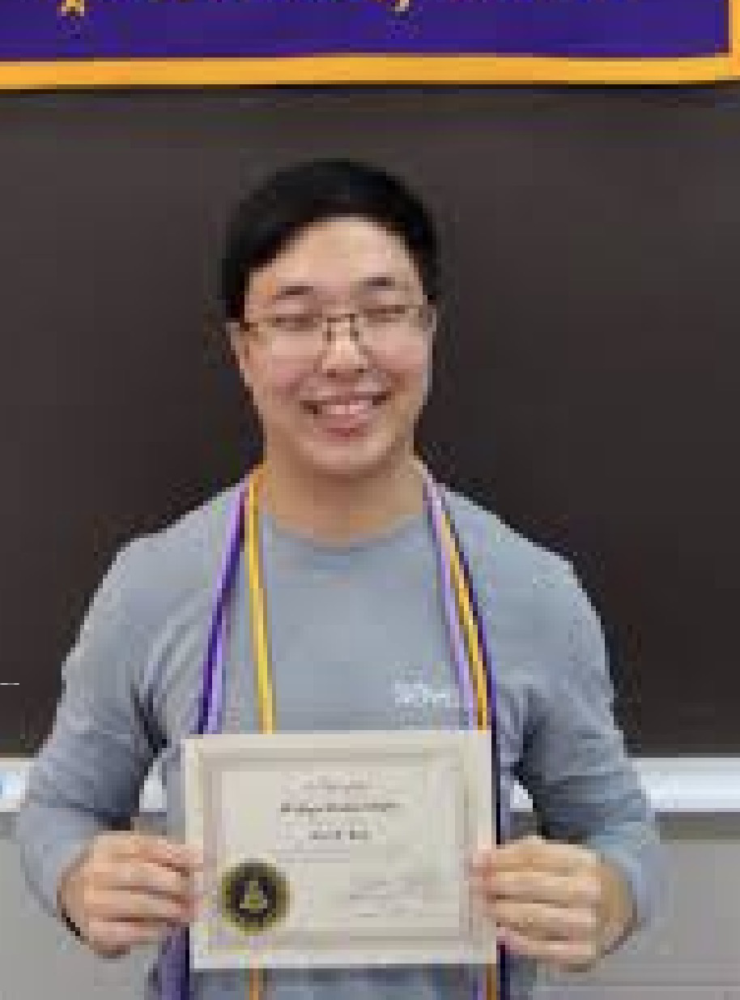
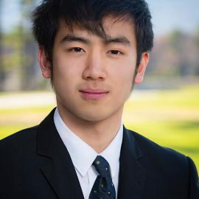
Meng Jiang
Associate Professor
Wenhao Yu
Bloomberg Fellowship
ICLR’23, EMNLP’22 * 2, ACL’22 * 2,
EMNLP’21 * 2, NAACL’21, WWW’20 * 2
LLM and Open-domain QA
Qingkai Zeng
KDD’21, EMNLP’20
Information Extraction
Taxonomy Construction
Faculty
PhD Cand.
Zhihan Zhang
TACL’23, EMNLP’22
LLM and Open-domain QA
Instruction Tuning
Noah Ziems
ACL’23
LLM and Open-domain QA
Controlled Text Generation
Mengxia Yu
CSE Select Fellowship
LLM for Education
Comparative Reasoning
PhD Student
Lingbo Tong
Psychology-CSE Joint PhD
LLM for Mental Health
Knowledge Graph
Hy Dang
LLM for Mental Health
Query Expansion
Bang Nguyen
LLM for Education
Query/Question Generation
Zhaoxuan Tan
LLM for User Modeling
Mengzhao Jia
LLM for User Modeling
Eric Inae
Dean’s Fellowship
Zheyuan Liu
Gang Liu
KDD’22, KDD’23
GNN for Material Science

Slide 29

Welcome to visit our lab!
http://www.meng-jiang.com/lab.html
https://github.com/DM2-ND
mjiang2@nd.edu
28

